Slide 1


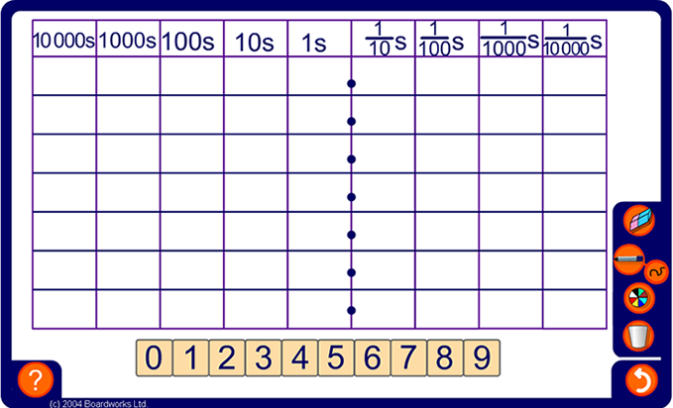


Place value
Notes:
Before starting the activity make sure that pupils can verbally describe the column headings and understand that the place value grid can be extended in both directions.
Describe the decimal point as a means of separating the whole number part of a number from the fractional part.
Start by dragging an example onto the grid, for example 6304.907.
Ask what the 6 is worth in this position (6 thousand), what the 3 is worth in this position (3 hundred), and so on.
Discuss the importance of the zero place holder.
Ask pupils to tell you the most important digit in this number. Establish that this is the 6 because it is worth 6 thousand. Although 9 is a bigger digit, it is only worth 9 tenths. We call 6 the most significant digit.
Ask pupils to add and subtract 0.001, 0.01 then 0.1 from the number. Note that to subtract 0.01 from this number we need to take 1 from the tenths column, then swap the 0 for a 9 to give 6304.897. Compare this with subtracting 10 from 907. Also, since there is a 9 in the tenths column, the effect of adding 0.1 is to add one to the digit in the units column to give 6305.007. Compare this with adding 100 to 4907.
The place value grid can also be used to demonstrate multiplying and dividing numbers by 10, 100, 1000, 0.1 and 0.01. Groups of digits can be dragged to the left and right to show this.

